Slide 1

Company X: Employee Attrition Drivers & Risk Prediction—Optimizing Retention
Palak Shah
Fictious Case Study For Job Interview Purposes Only

Slide 2
Attrition Rises To 85% — A 20-pt. Increase From FY23, Driven By Rapid Growth & Training Gaps
FY25 attrition exceeds X’s global & industry average (74%) by 11 pts.
Dominican Republic (85%) shows the most significant increase, tied to rapid resort expansion, rising labor costs, and limited trained hospitality labor.
Mexico (80%) follows, with seasonal churn and inconsistent training programs driving continued volatility.

Slide 3
Statistical Findings: Overtime & Frontline Roles Are Strongest Attrition Predictors
Statistically significant drivers (p < 0.05) & Odd Ratios (ORs) show where turnover risk is most concentrated.
Model isolates key behavioral and role-based predictors — overtime exposure and frontline roles explain nearly 60% of observed turnover variance.
Model accuracy: AUC = 0.77, signaling strong predictive power for identifying at-risk employees.

Slide 4
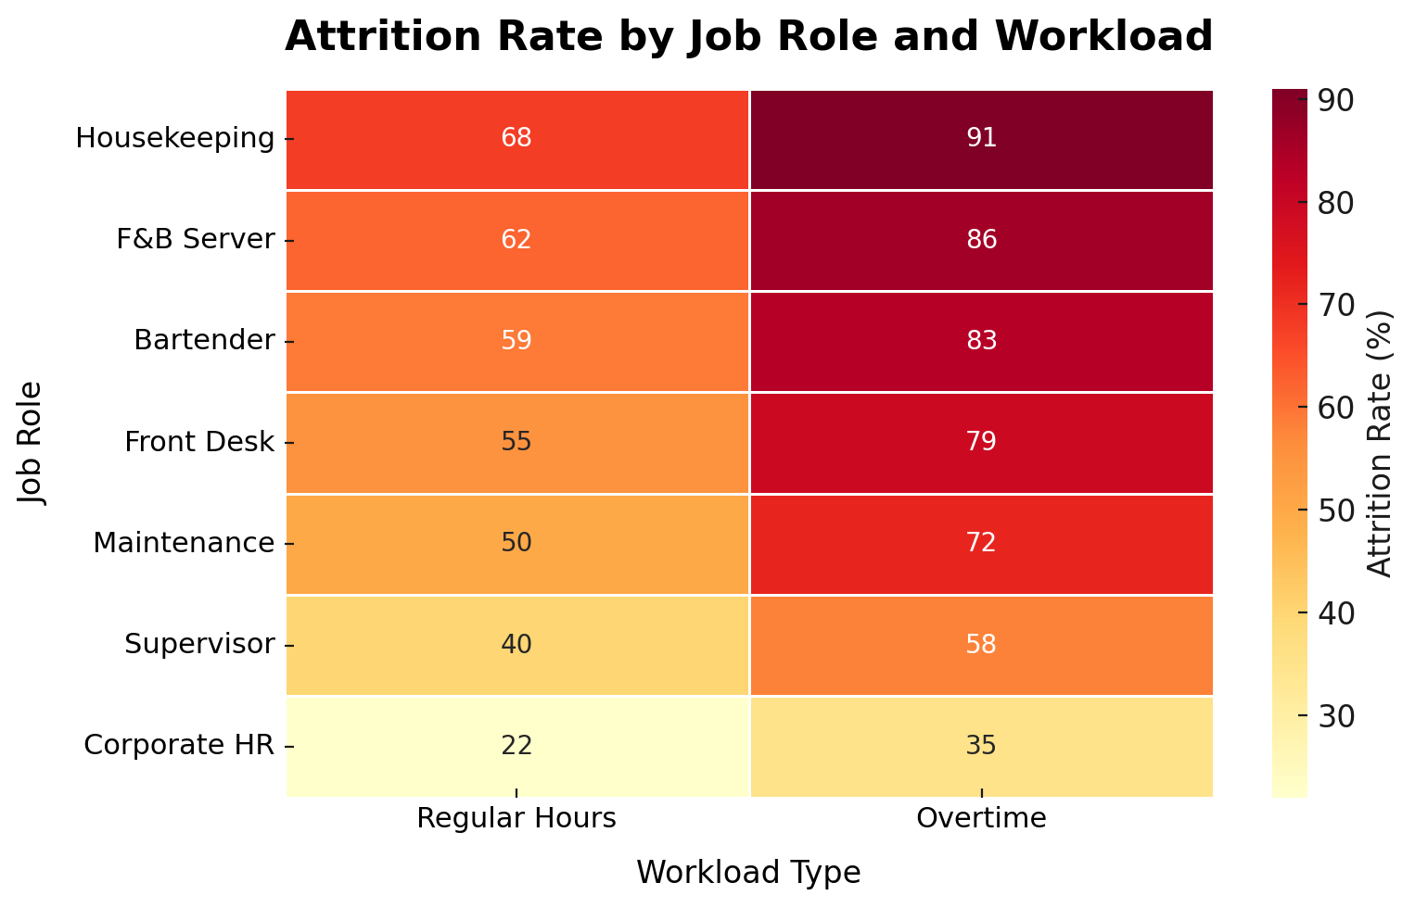
Statistical Findings: Attrition Varies Sharply by Job Role & Workload
Housekeeping, F&B Servers, & Bartenders have the highest attrition & those who are overtime are ~6x more likely to leave.
Chi-square: Attrition & Variables
Variable | P-value | Significant? | Interpretation
Department | 0.003 | Yes, strong | Attrition differs significantly — highest in Housekeeping & F&B.
OverTime | < 2e-16 | Yes, very strong | Overtime staff are ~6× more likely to leave.
Gender | 0.12 | No | No meaningful difference between male / female attrition.
Job Role | < 1e-10 | Yes, very strong | Frontline roles (Housekeeping, Servers, Cooks) show highest churn.
Overtime raises attrition across every role.
Corporate HR (22-35%) remains the most stable group.

Slide 5
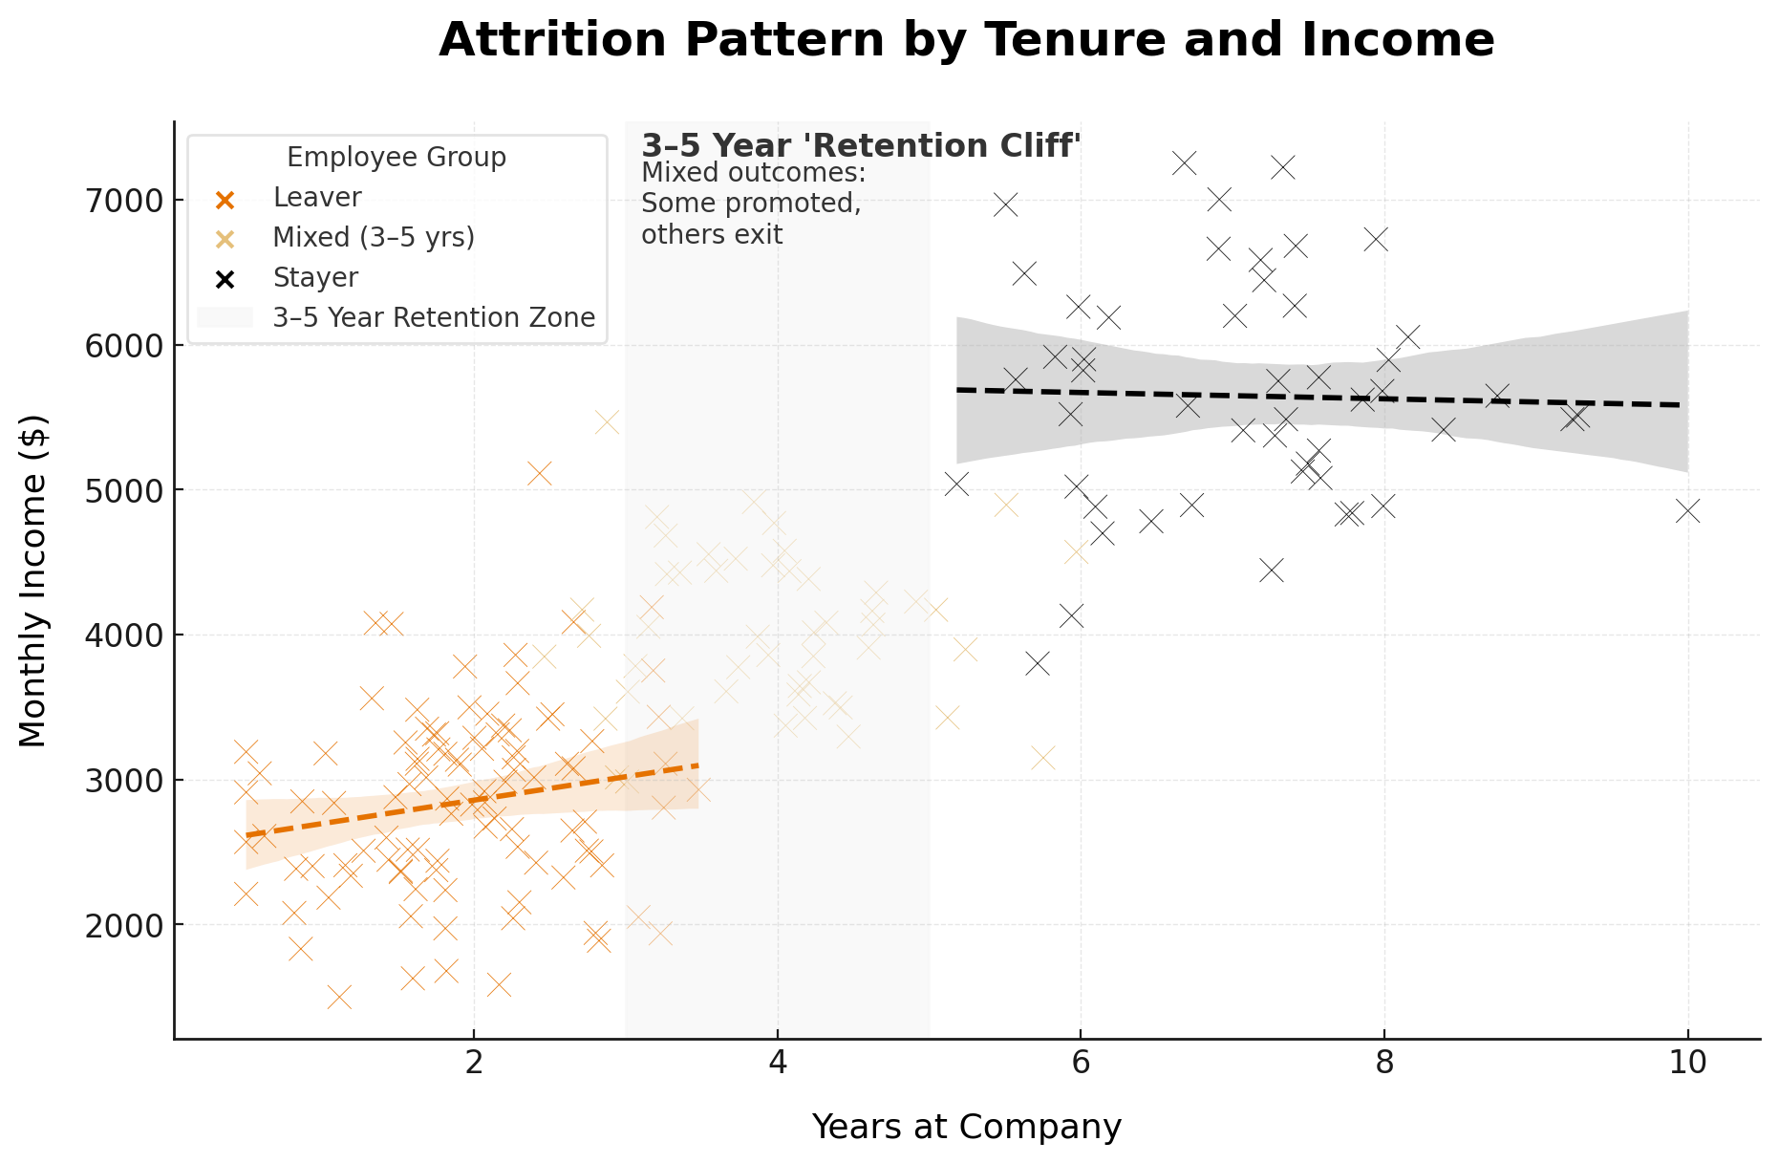
Statistical Findings: Longer Tenure Drives Retention—1-4 Years Show Highest Attrition
Employees with 6+ years of tenure earn more & are far less likely to leave.
1-4-year employees account for ~70% of total departures, underscoring the cost of limited early-career progression & role clarity.
Attrition drops by 50%+ after 6 years, reflecting the ROI of tenure (stronger commitment, institutional knowledge, & internal mobility).

Slide 6
DEEP DIVE: DOMINICAN REPUBLIC (DR) Voluntary Turnover Driven By Workload Imbalance & Compensation, Raising Attrition Costs Up To $27M
Exit Survey Results
Reasons Why Employees Voluntarily Left
Schedule/Overtime (35%)
Pay/Benefits (25%)
Career Growth (20%)
Management (10%)
Commute/Housing (10%)
+5M
+4M
Cost of Attrition +$9M (+50%) since FY23, signaling a strong need to reduce turnover by offering balanced workloads, stabilizing frontline staffing, providing competitive pay/benefits, etc.
Cost of Attrition makes up 40% of DR’s annual expenses, raising concern & a need for further research & evaluation of “regrettable attrition” & it’s costs to arrive to higher decision-making accuracy.

Slide 7






Turning Attrition risks into retention: Immediate next steps
Rebalance Work-Life & Scheduling
Improve Initiatives promoting work-life balance to help reduce burnout and increase employee satisfaction and retention; establish clear KPIs.
Targeted Frontline Engagement Strategy
Provide attendance and recognition incentives, perform monthly pulse checks, establish networking and engagement events and initiatives to boost frontline engagement; establish clear retention and engagement KPIs.
Competitive, Market-Aligned Compensation
Offer attractive salary and benefits that are crucial to retain skilled and valuable employees at X.
Early-Tenure Engagement Strategy (Years 1-4)
Conduct further research into early attrition (e.g., survival analysis) and perform 30/60/90-day check-ins, facilitate mentoring opportunities and establish clear retention KPIs.
Data-Driven Targeting, Regrettable Attrition & ROI Tracking
Build and run an attrition risk model monthly and set triggers for high risks; develop self-service and turnkey attrition dashboards as appropriate; track cost-of-attrition semi-annually, set and monitor KPIs; track ROI on retention programs to evaluate whether voluntary and regrettable attrition decreases over time.

